Slide 1

Grocery Delivery Application
Guided by: Team Members:
A. Varadharajan S. Aarthy (EBEON1222708290)
S. Kaviya (EBEON1222714256)
C. Priyadharshini (EBEON1222705676)
T. Ranjithapriya (EBEON1222722728)
Supporter & Sponsor,
Edubridge India P L & Capgemini

Slide 2
ABSTRACT
An online Grocery store permits a customer to submit online orders for items and/or services from a store that serves online customers. The online store system provides an online display of all the items they want to sell.
This web based application helps customers to choose their daily needs and products to their shopping cart. Customers provide their complete detail of address and contact and they get their chosen products in their home.

Slide 3
Technologies
Spring boot
Maven
Java8
My SQL
Hibernate
Angular
Html
CSS
Java script
Typescript

Slide 4
LIST OF MODULES
Registration and Login
Home Page
Chat Bot
Product Category
Order and Payment History
Cart Process
Payment process
SMS Sending
GPS Tracking

Slide 5
MODULES DESCRIPTION
Module 1: Cart Process
A shopping cart is a piece of software that keeps the record of the items a buyer has ’picked up’ from the online store.
The add-to-cart button is a feature of ecommerce stores that allows customers to choose items to purchase without actually completing the payment.

Slide 6
UML DIAGRAM
View product
Add to shopping cart
Empty cart
Show more
checkout
View shopping cart
Customer

Slide 7
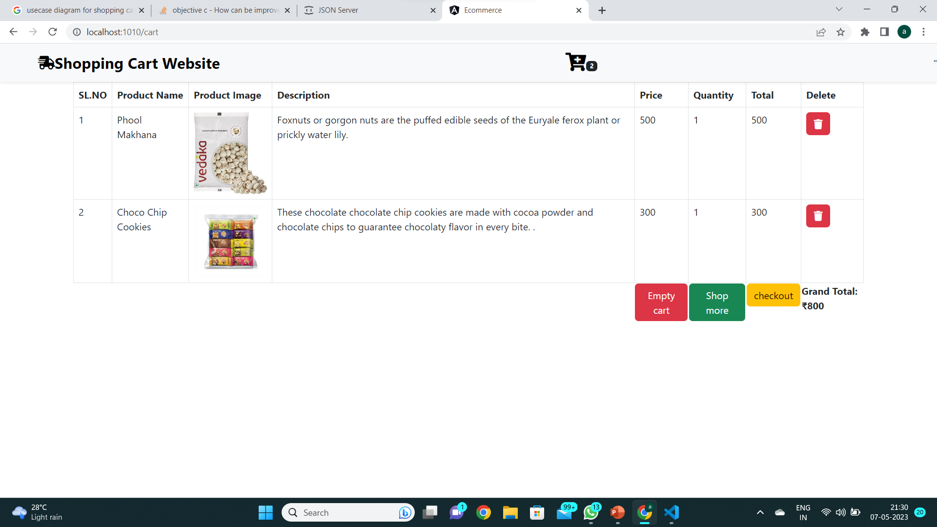

Slide 8
cont’d
Module 2: Payment Process
Online payment allows you to pay money via the internet. Buyers will use this type of payment when they purchase goods online or offline.
They can use different types of online payment methods, including debit/credit cards, wire transfers, net banking, and digital wallets.

Slide 9
UML DIAGRAM
payment
Pay now
Customer
Card number
Address
Email Id

Slide 10
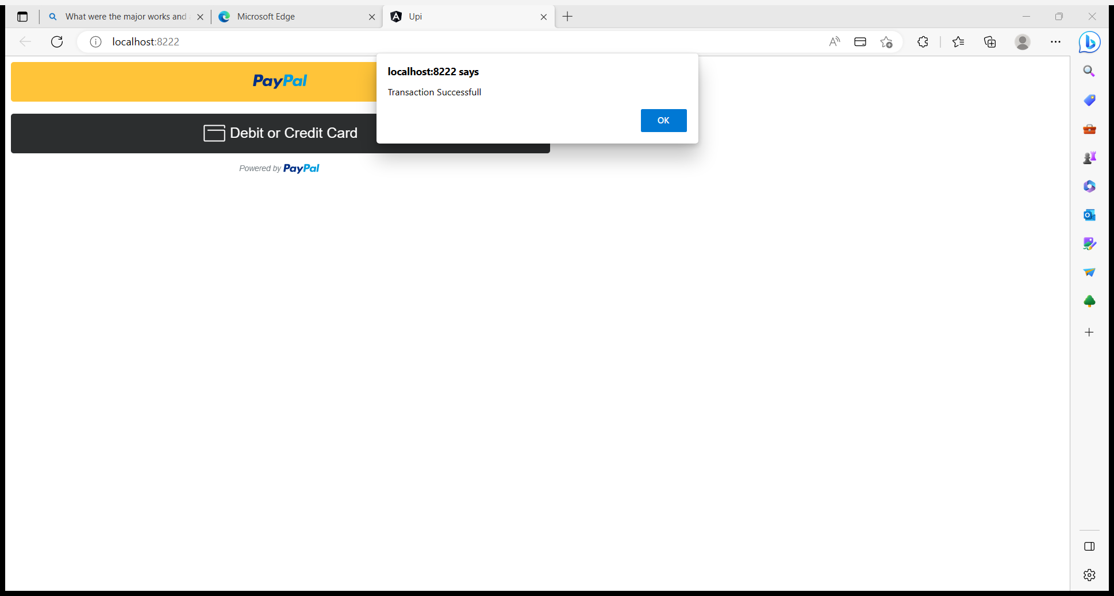

Slide 11
CONCULSION
Online shopping is becoming more popular day by day with the increase in the usage of World Wide Web ,Understanding customer’s need for online selling has become challenge for marketers .Specially understanding the consumer’s attitudes towards online shopping , making improvement in the factors that influence consumers to shop online and working on factors that affect consumers to shop online will help marketers to gain the competitive edge over others.

Slide 12
THANK YOU

